Slide 1
Fundamentals of molecular biology
History and scope of Molecular Biology
By
Dr. Nelson Xess
Department of Microbiology
Bhanupratap Deo Govt. P.G College, Kanker, Chhattisgarh

Slide 2
Griffith showed that heatkilled bacteria can transform living cells.
the bacterium Streptococcus pneumoniae comes in two forms that differ from one another in their microscopic appearance and in their ability to cause disease. Cells of the pathogenic strain, which are lethal when injected into mice, are encased in a slimy, glistening polysaccharide capsule. When grown on a plate of nutrients in the laboratory, this disease-causing bacterium forms colonies that look dome-shaped and smooth; hence it is designated the S form. the harmless strain of the pneumococcus, on the other hand, lacks this protective coat; it forms colonies that appear flat and rough— hence, it is referred to as the r form. As illustrated, Griffith found that a substance present in the pathogenic S strain could permanently change, or transform, the nonlethal r strain into the deadly S strain.
In the course of his investigations, Griffith injected various preparations of these bacteria into mice. He showed that pathogenic pneumococci that had been killed by heating were no longer able to cause infection. The surprise came when Griffith injected both heat-killed pathogenic bacteria and live harmless bacteria into the same mouse. This combination proved lethal: not only did the animal die of pneumonia, but Griffith found that its blood was teeming with live bacteria of the pathogenic form. The heat-killed pneumococci had somehow converted the harmless bacteria into the lethal form. What’s more, Griffith found that the change was permanent: he could grow these “transformed” bacteria in culture, and they remained pathogenic. But what was this mysterious material that turned harmless bacteria into killers? And how was this change passed on to progeny bacteria?

Slide 4
Some Experiments on the Transforming Principle. Earlier experiments done by Avery, MacLeod, and McCarty had shown
That only DNA extracts from S cells caused transformation of R cells to S cells. To demonstrate that contaminating molecules in the DNA extract were not responsible for transformation, the DNA extract from S cells was treated with RNase, DNase, and protease and then mixed with R cells. Time was allowed for the DNA from S cells to be taken up by the R cells and expressed, transforming R cells into S cells. Then, antibodies (immune system proteins that recognize specific structures) that recognized R cells, but not S cells, were added to the mixture. The addition of antibodies caused the R cells (i.e., those R cells that had not been transformed) to aggregate. These aggregated R cells were removed from the mixture by gentle centrifugation. Thus, the only cells remaining in the mixture were cells that had been transformed and were now S cells. Only treatment of the DNA extract from S cells with DNase destroyed the ability of the extract to transform the R cells.

Slide 6
The Hershey-Chase experiment. Two batches of isotopically
labeled bacteriophage T2 particles were prepared. One was labeled with 32P in the phosphate groups of the DNA, the other with 35S in the sulfur-containing amino acids of the protein coats (capsids). (Note that DNA contains no sulfur and viral protein contains no phosphorus.) The two batches of labeled phage were then allowed to infect separate suspensions of unlabeled bacteria. Each suspension of phage-infected cells was agitated in a blender to shear the viral capsids from the bacteria. The bacteria and empty viral coats (called “ghosts”) were then separated by centrifugation. The cells infected with the 32P-labeled phage were found to contain 32P, indicating that the labeled viral DNA had entered the cells; the viral ghosts contained no radioactivity. The cells infected with 35S-labeled phage were found to have no radioactivity after blender treatment, but the viral ghosts contained 35S. Progeny virus particles (not shown) were produced in both batches of bacteria some time after the viral coats were removed, indicating that the genetic message for their replication had been introduced by viral DNA, not by viral protein.

Slide 7
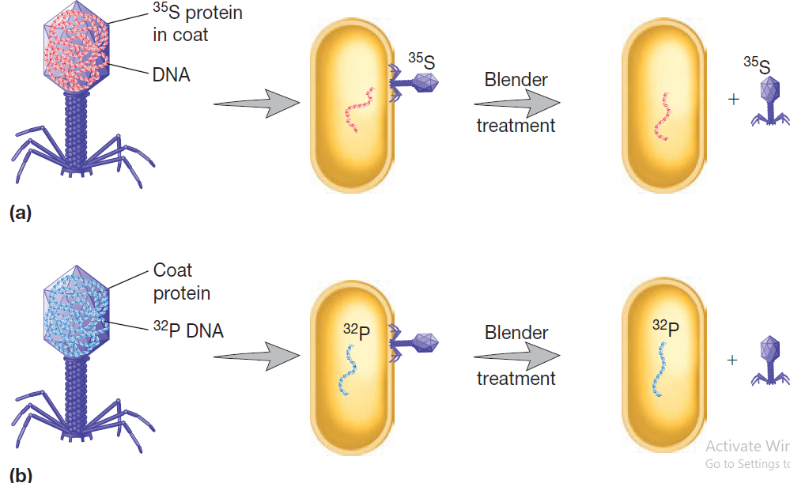
The Hershey-Chase Experiment.
When E. coli was infected with a T2 phage containing 35S protein, most of the radioactivity remained outside the host cell.
(b) When a T2 phage containing 32P DNA was mixed with the host bacterium, the radioactive
DNA was injected into the cell and phages were produced.Thus DNA was carrying the virus’s genetic information.

Slide 8
Hershey and Chase showed definitively that genes are made of DNA.
(a) the researchers worked with T2 viruses, which are made entirely of protein and DNA. each virus acts as a molecular syringe, injecting its genetic material into a bacterium; the empty viral capsule remains attached to the outside of the cell. (B) to determine whether the genetic material of the virus is protein or DNA, the researchers radioactively labeled the DNA in one batch of viruses with 32p and the proteins in a second batch of viruses with 35S. Because DNA lacks sulfur and the proteins lack phosphorus, these radioactive isotopes provided a handy way for the researchers to distinguish these two types of molecules. these labeled viruses were then allowed to infect E. coli, and the mixture was disrupted by brief pulsing in a Waring blender to separate the infected bacteria from the empty viral heads. When the researchers measured the radioactivity, they found that most of the 32p-labeled DNA had entered the bacterial cells, while the vast majority of the 35S-labeled proteins remained in solution with the spent viral particles.

Slide 9
DNA is made of four nucleotide building blocks.
Each nucleotide is composed of a sugar–phosphate covalently linked to a base.
(B) the nucleotides are covalently linked together into polynucleotide chains, with a sugar–phosphate backbone from which the bases (a, C, G, and t) extend.
(C) a DNA molecule is composed of two polynucleotide chains (DNA strands) held together by hydrogen bonds between the paired bases. the arrows on the DNA strands indicate the polarities of the two strands, which run antiparallel to each other in the DNA molecule.
(D) although the DNA is shown straightened out in (C), in reality, it
is wound into a double helix, as shown here.

Slide 10
DNA Replication Modes
Conservative
Semi Conservative
Dispersive

Slide 11
Principle of DNA Replication
Principal- based on semi conservative theory.
The DNA replicates itself to make multiple copies in this process. In conservative replication, two DNA copies are produced from one original DNA, which serves as a template. Out of these two, one is entirely new DNA, and the other is made of old DNA strands.

Slide 12
Semi conservative DNA Replication

